Slide 1
Chapter 3: Historical, Current, and Future Applications of Ultrasound in Medicine

Slide 2
Chapter Objectives
Explore the study of sound and the history of acoustics.
Develop an appreciation for those individuals who made contributions to the study of sound.
Provide an overview of the use of ultrasound in medicine.
Analyze the specialties within the sonography profession.
Offer some information regarding current and future applications of ultrasound in medicine.

Slide 3
The Study of Sound
Sound is a form of energy that is produced when a vibrating source causes molecules within a medium to move back and forth.
The back-and-forth motion allows waves of sound energy to travel.
The human body is made of different mediums that allow sound to propagate.
The scientific study of sound is referred to as acoustics.
Boethius identified the pebble theory, which visualizes sound waves traveling like the waves created by a pebble dropped in water.
Leonardo da Vinci also assumed the sound traveled in waves, identified that angle of reflection = angle of incidence.
Robert Boyle recognized there must be a medium through which sound can travel in order for it to propagate.
His research laid the groundwork for the use of coupling gel.

Slide 4
The Study of Sound (cont.)
Abbe Lazzaro Spallanzani, the “father of ultrasound,” studied how bats use sound waves to detect their victims and to guide their flight.
By recalling this, we can recognize how the ultrasound transmitter utilizes the pulse-echo technique.
Christian Johann Doppler discovered that the pitch of a sound wave varies if the source of the sound was moving (the Doppler effect).

Slide 5
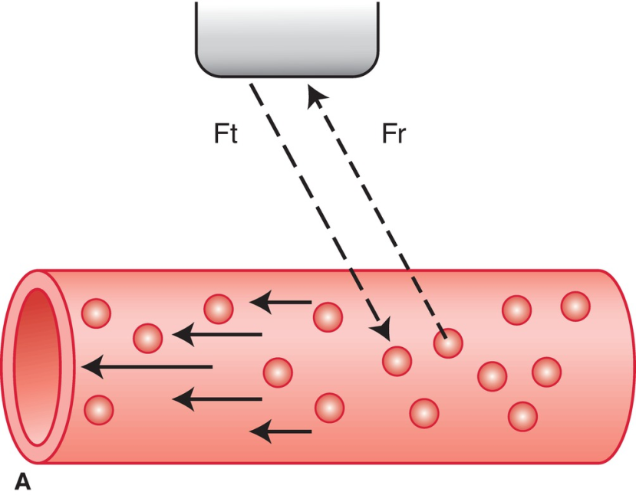
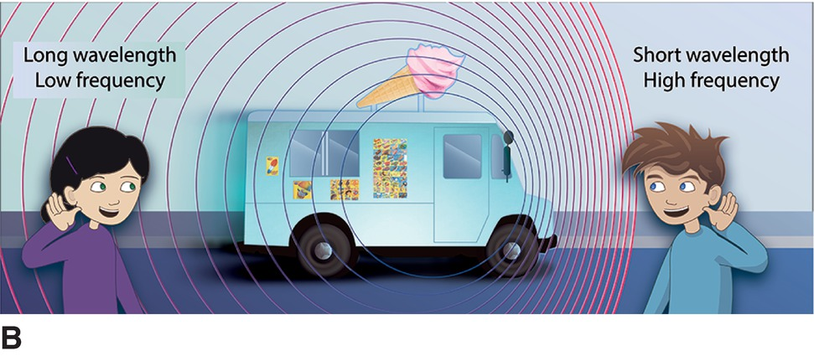
The Study of Sound (cont.)
A. The transmitted Doppler sound beam (Ft) encounters red blood cells (RBCs) moving toward the transducer within the blood vessel. The ultrasound instruments detect and measure the frequency (Fr) of the returning Doppler signal, confirming the presence of blood flow and the direction in which the blood is traveling.
B. Illustration of the Doppler effect where the frequency of sound increases when object moves toward the boy and decreases when object recedes away from the girl.

Slide 6
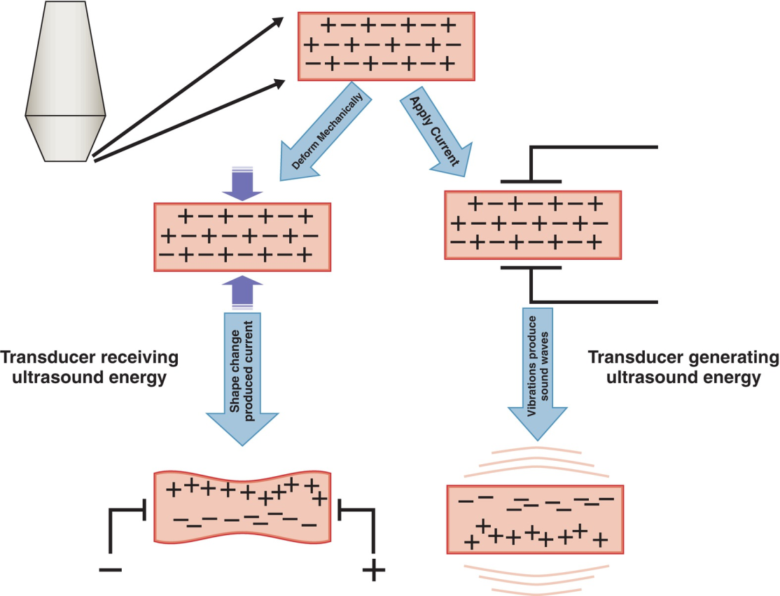
The Study of Sound (cont.)
The Currie brothers recognized the piezoelectric effect.
This is the process whereby a material, such as a crystal or element within an ultrasound transducer, generates electricity and changes shape with application of pressure.
The crystals in the transducer produce ultrasound waves.

Slide 7
Ultrasound in Medicine
During World War I, ultrasound was used to detect submarines.
This led to the development of sonar technology, with used sound that was sent through the water, bounced off an object, and then returned to the source.
Floyd Firestone used this to develop and use the reflectoscope, which used ultrasound to detect flaws in metal.
This was the technique first used in medicine.
The first application of ultrasound in medical diagnosis was in 1941.
Karl Dussik used it to image the lateral ventricles in the brain.
As research progressed, scientists realized the ultrasound waves returned to the transducer and may be able to form an image.

Slide 8
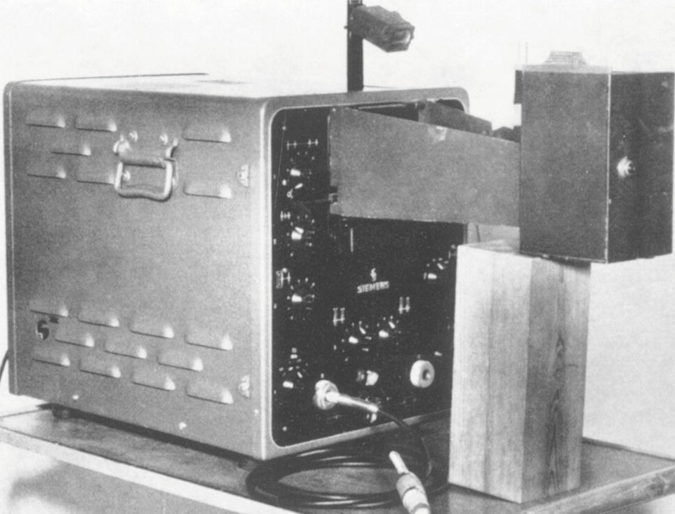
Ultrasound in Medicine (cont.)
Edler and Hertz used an ultrasonoscope, seen here, to record their early echocardiograms

Slide 9
Ultrasound in Medicine (cont.)
The pulse-echo technique sought to exploit reflected sound back from within the body to create an image.
Sound must be pulsed or allowed to be alternated rapidly on and off so the transducer can listen for the echo.
Upon hearing the echo, the machine calculates distance and presents the reflector’s location on the monitor.
Efforts to use the technique were first made in the late 1940s and early 1950s.
One early attempt demonstrated reflections from a gallstone.
In another, a Swedish cardiologist borrowed a sonar device from a shipyard and recorded echoes from his own heart.

Slide 10
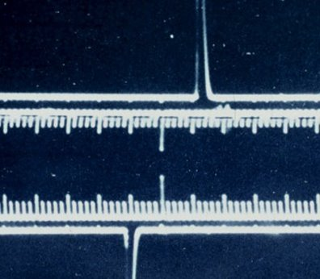
Imaging Modes and Doppler
Display Options
A-mode (amplitude mode) represents the depth of the returning echo on the x-axis and the strength (amplitude) of the reflector on the y-axis.
A pulse of sound was sent out to create one scan line of information interpreted to represent depth and amplitude.
This is used in echocardiography and ophthalmic ultrasound.

Slide 11
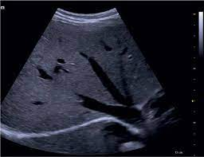
Imaging Modes and Doppler
Display Options
B-mode (brightness mode) displays the returning ultrasound signal as a dot on the monitor.
The dot has varying degrees of brightness, based on the strength of the returning echo.
The stronger the returning echo, the brighter the dot.
This is also referred to as grayscale sonography.

Slide 12
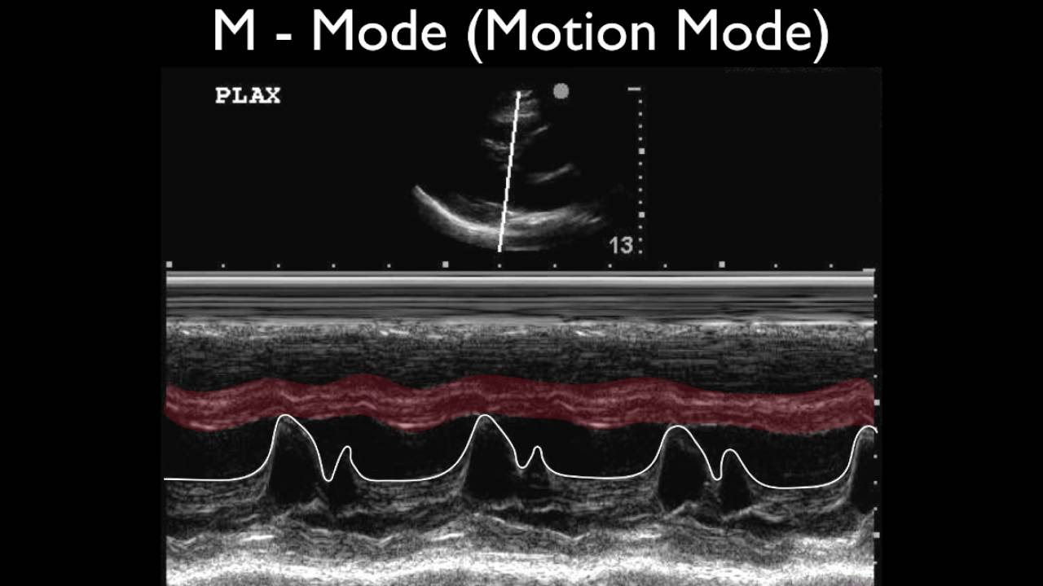
Imaging Modes and Doppler (cont.)
Display Options (cont.)
M-mode (motion mode) documents the movement of structures in the body along a single scan line.
The y-axis shows depth; the x-axis shows time.
M-mode is used to demonstrate fetal heart rate and in echocardiography as a critical part of standard protocols.
The original ultrasound machines provided static images; now we are able to use real-time scanners.

Slide 13
Imaging Modes and Doppler (cont.)
Doppler Technology
Robert Rushmer and his colleagues established the varying uses of continuous-wave (CW) Doppler and spectral analysis in 1963.
CW transducers combine an element continuously sending waves with one that continuously listens for the return signal.
In the 1970s, there were several advancements, including:
Pulsed-wave Doppler
Duplex imaging, two modes of ultrasound, B-mode and Doppler
Advancements in color Doppler imaging and instrumentation
The combination of B-mode, spectral, and color Doppler is called triplex imaging.

Slide 14
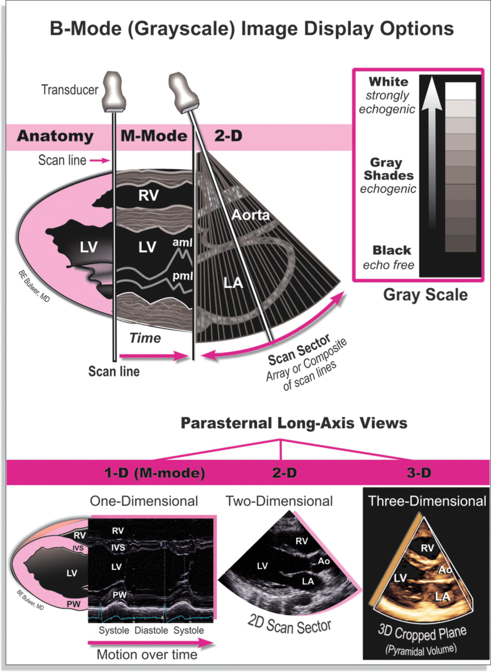
Imaging Modes and Doppler (cont.)

Slide 15
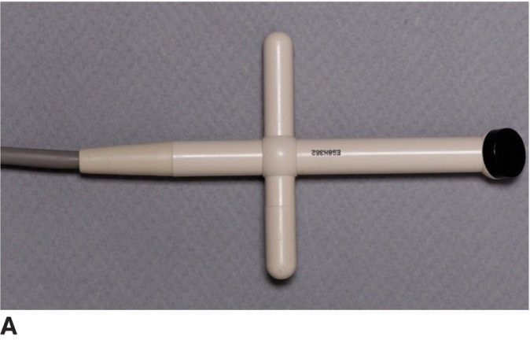
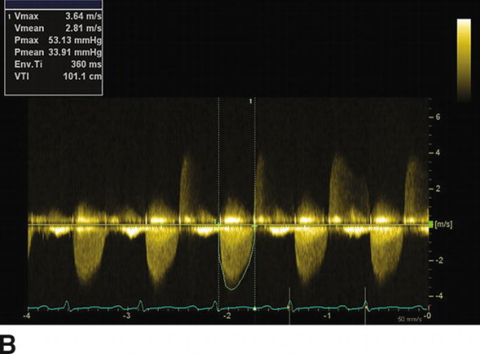
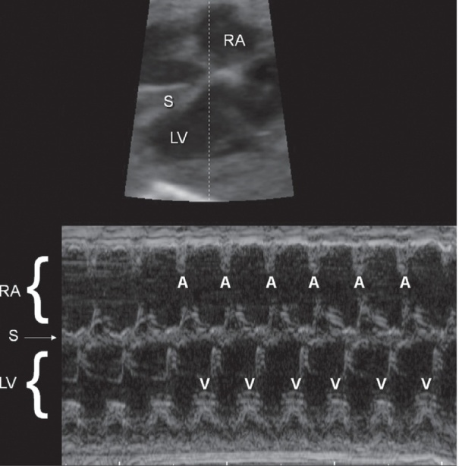
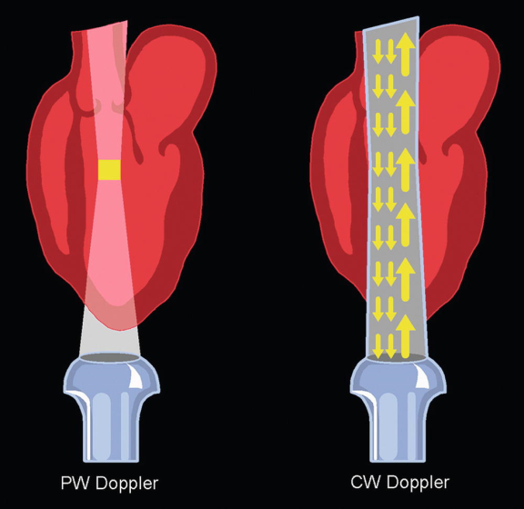
Imaging Modes and Doppler (cont.)
A Pedoff probe or continuous-wave (CW) Doppler transducer. A CW transducer contains two elements: one for transmitting and one for receiving. B. Waveform produced by a Pedoff probe.
M-mode of the fetal heart
PW vs. CW

Slide 16
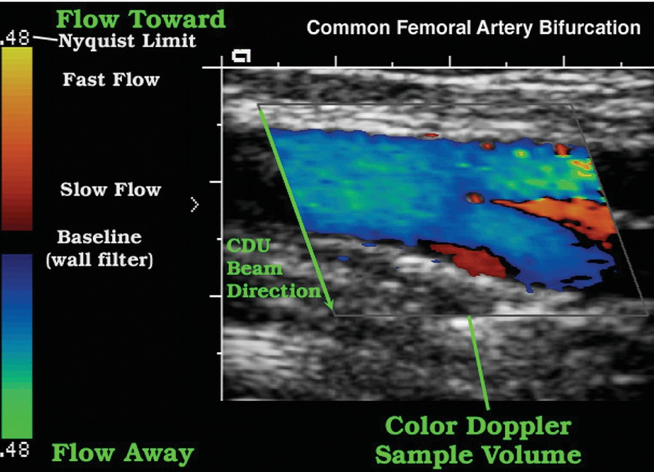
Imaging Modes and Doppler (cont.)
Color Doppler

Slide 17
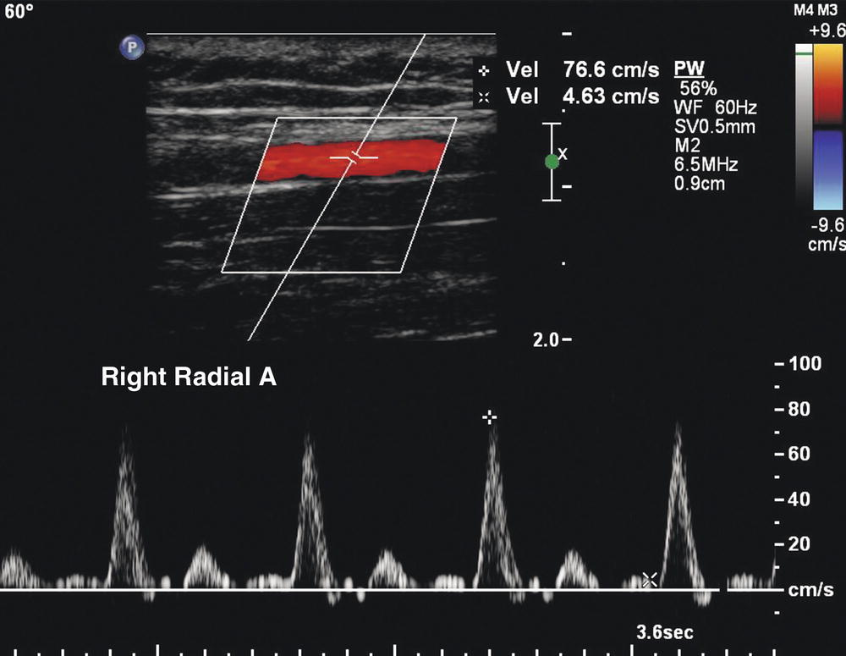
Imaging Modes and Doppler (cont.)
Duplex imaging. Normal radial artery duplex image shows triphasic spectral waveforms.

Slide 18
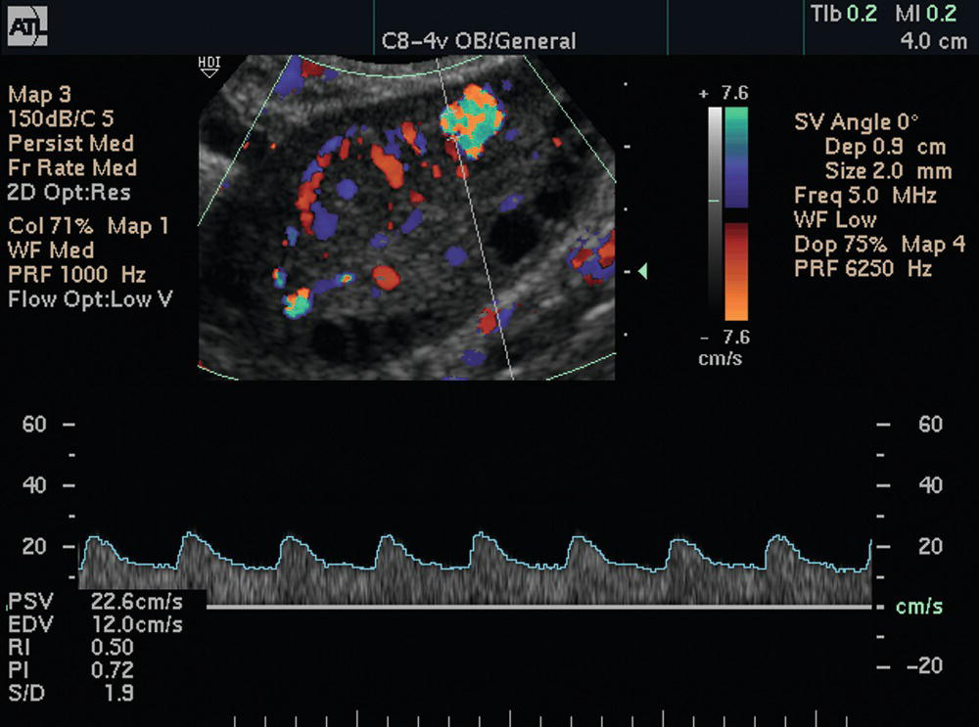
Imaging Modes and Doppler (cont.)
Triplex imaging

Slide 19
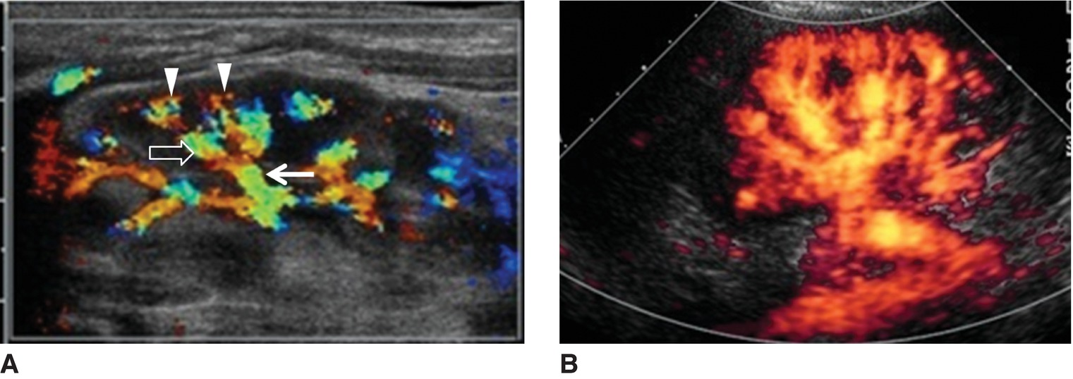
Imaging Modes and Doppler (cont.)
A. Color Doppler
B. Power Doppler

Slide 20
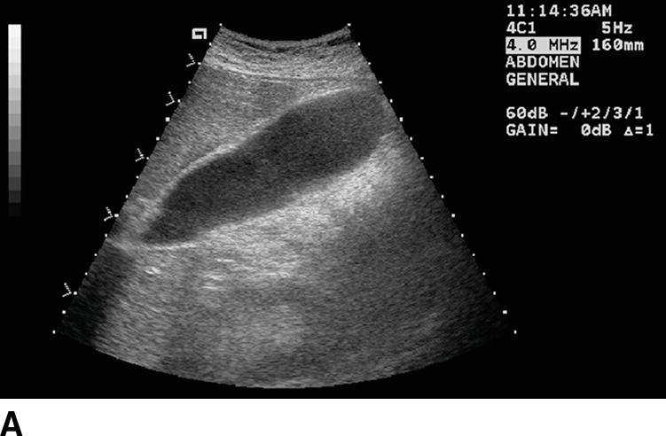
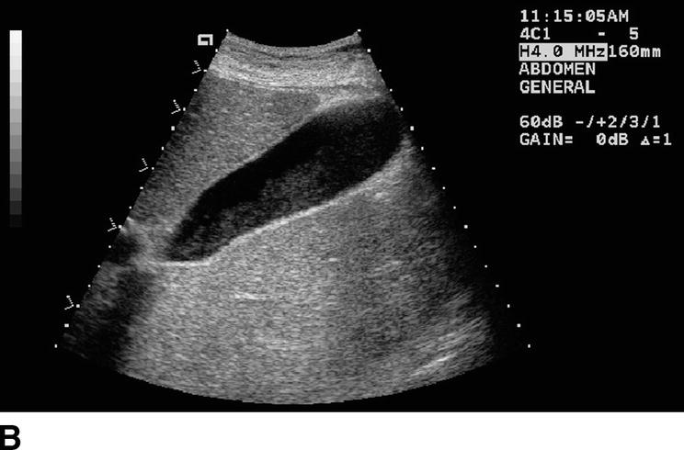
Tissue Harmonic Imaging
Harmonics are additional frequencies, other than the transmitted frequency sent into the body, that are generated by differing human body tissues.
These are collected by the transducer and used to create a crisper, higher-resolution image.

Slide 21
3D and 4D Technology
3D allows one to see the width, height, and depth of images.
It is useful in obstetrics for clear visualization of the form of the fetal face.
It is also used in breast, vascular, gynecologic, and abdominal sonographic imaging.
The images are made of two 2D images placed next to each other and reconstructed by a computer into a 3D format.
A 3D image can be created through several processes:
Manual movement of the transducer across a specific path
Use of a mechanical 3D transducer
Use of a 2D transducer

Slide 22
3D and 4D Technology (cont.)
Volumetric imaging helps address the concern of depending on the skill of the sonographer to acquire diagnostic imaging.
An offline workstation is used to do digital postprocessing of images.
The sonographer finds a good window and completes just one sweep from lateral to medial.
A computer recreates 3D images.
There are some limitations to 3D technology:
Optimal imaging of the fetal face depends on enough amniotic fluid and favorable fetal positioning.
For some applications, a 2D image provides enough information for diagnosis; a 3D image simply confirms.

Slide 23
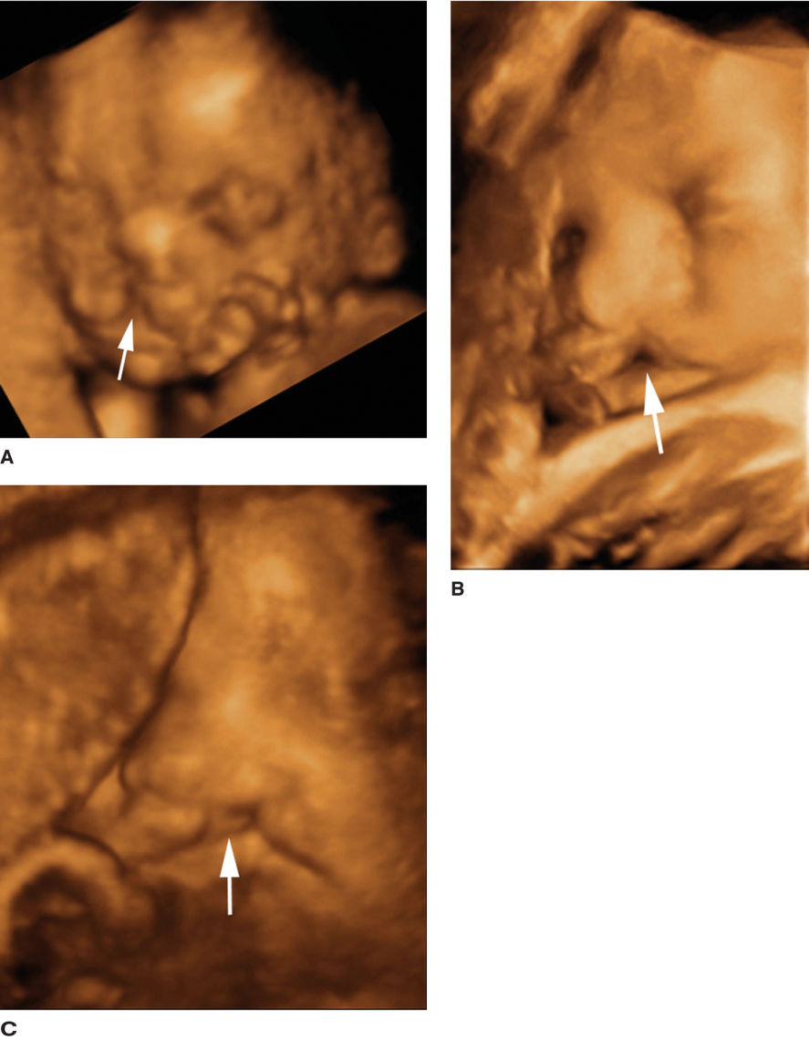
3D and 4D Technology (cont.)

Slide 24
3D and 4D Technology (cont.)
4D ultrasound offers real-time images in 3D.
The fourth dimension is time.
The use of the technology is still evolving.
Keepsake imaging centers exploit 3D and 4D images for economic and entertainment purposes.
The American Institute of Ultrasound in Medicine’s official statement calls for certified professionals and licenses physicians to maintain appropriate patient care.

Slide 25
Specialities in Sonography
Abdominal Sonography
Abdominal sonographers must appreciate relevant normal abdominal anatomy and pathology of each organ and system within the abdomen and small parts.
Transducer frequency ranges 2 to 5 MHz for general imaging.
CW and PW Doppler are often utilized to assess vascular structures and provide evidence of blood flow within abdominal masses and organs.
Abdominal sonographic imaging includes a wide variety of abdominal structures and can be ordered for numerous reasons.
Abdominal sonographers may assist the physician in invasive procedures or evaluate for renal artery stenosis or assist during endoscopic ultrasound.
Patient prep is typically nothing by mouth for 6+ hours prior.

Slide 26
Specialities in Sonography (cont.)
Abdominal Sonography: Small Parts Sonography
Small parts include the thyroid, scrotum, and prostate gland.
Abdominal sonographers may also:
Perform breast sonography
Evaluate the penis, chest, specific painful joints or tendons, bowels, the abdominal wall for hernias, and palpable masses to confirm evidence of foreign bodies.
Scan any external body part to which both acoustic gel and the transducer can be applied.
The majority of small parts require the use of a linear transducer and, sometimes, the use of an acoustic stand-off device.
Challenges can arise from large patient body habits, bowel gas, surgical bandages, patient preparation, lack of compliance, or intolerance.

Slide 27
Specialities in Sonography (cont.)
Breast Sonography
This is used in conjunction with mammography and physical examination.
Sonography is the initial modality of choice for patients under 30 and those who are pregnant or lactating.
Sonography can differentiate cystic versus solid masses; mammography often cannot.
Other uses include possible breast implant rupture, during needle placement for biopsy, cyst drainage, and radio-frequency ablation.
Breast sonography should be performed with a high-resolution, real-time linear array transducer with a frequency of at least 10 MHz.
A supine-oblique position with the ipsilateral arm raised is often used.

Slide 28
Specialities in Sonography (cont.)
Breast Sonography (cont.)
The breast is visualized like the face of a clock.
Imaging is performed in transverse and longitudinal planes or radial and antiradial planes.
Breast sonographers should have a thorough appreciation of mammography techniques and breast pathology noted on a mammogram.
Interpretation often integrates Breast Imaging Reporting and Data System (BI-RADS).
One of the main concerns is that sonography is highly operator dependent.
Automated whole breast scanners allow for better reproducibility and correlation with other modalities.

Slide 29
Specialities in Sonography (cont.)
Neurosonography and Pediatric Sonography
Neurosonography includes neonatal brain imaging, newborn infant spine imaging, and intraoperative sonography.
Sonography is a portable, high-resolution, economic alternative to other imaging studies.
Images are obtained routinely through the anterior fontanelle.
The infant spine is imaged with a high-frequency linear array transducer with frequency ranges 7 to 10 MHz.
The patient is placed prone.
Infants may be scanned as the result of suspicious intrauterine findings during an obstetric sonogram.
Neurosonography was once a distinct certification, but it has been replaced with certification in pediatric sonography.
Pediatric images follow protocols similar to adult imaging.

Slide 30
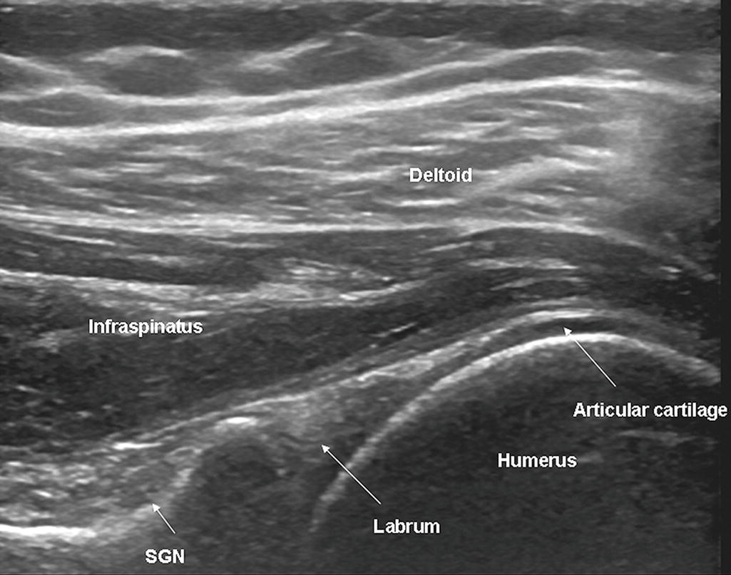
Specialities in Sonography (cont.)
Musculoskeletal Sonography
This includes evaluation of the shoulder, wrist, knee, and any other joints, tendons, and muscles of the extremities.
The search for foreign bodies may also be a requirement.

Slide 31
Specialities in Sonography (cont.)
Gynecologic Sonography
Patient preparation includes filling the urinary bladder.
This provides an acoustic window for visualizing the uterus, ovaries, and other structures in the adnexa.
Transabdominal sonography employs a transducer 3.5+ MHz.
Transvaginal sonography employs a transducer 5+ MHz.
Transvaginal sonography has several advantages:
Better resolution of organs and structures in large patients
Does not require a distended bladder
Saline infusion sonohysterography allows clear visualization of the endometrial lining and uterine cavity.
Sterile saline is injected with a catheter; the sonogram is performed during the procedure.

Slide 32
Specialities in Sonography (cont.)
Gynecologic Sonography (cont.)
The ability to assess the endometrium and ovaries has made significant impact on assisted reproductive therapy and fertility treatment.
Use in postmenopausal women is helpful in assessing bleeding.

Slide 33
Specialities in Sonography (cont.)
Obstetric Sonography
This is one of the most established and recognizable applications of ultrasound in medicine.
Sonographers practicing obstetrics must be familiar with fetal abnormalities and maternal complications.
There are several stages when a sonogram may be required:
In the first trimester:
To confirm intrauterine pregnancy
For vaginal bleeding
If an ectopic pregnancy is suspected
For screening secondary to high-risk clinical history findings
Routine assessment of maternal and fetal anatomy
Screening for genetic complications

Slide 34
Specialities in Sonography (cont.)
Obstetric Sonography (cont.)
In the second and third trimesters:
Routine and detailed anatomic survey
Obstetric sonographers may assist with interventional perinatal procedures, including:
Amniocentesis
Chorionic villus sampling
Cordocentesis
Fetal Echocardiography
This branch of obstetric sonography specializes in the fetal heart.
If a parent has a family history of congenital heart defects or if routine sonogram is suspicious, fetal echocardiogram is performed.

Slide 35
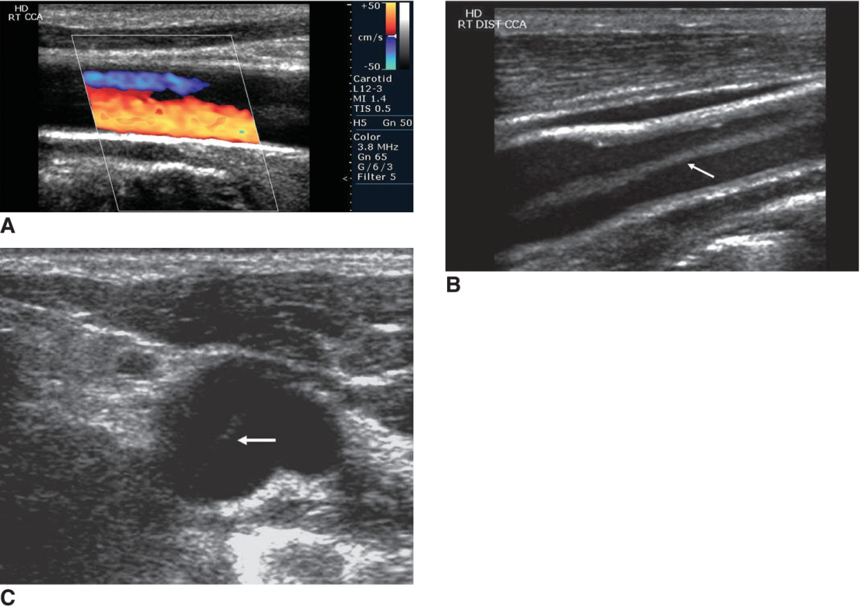
Specialities in Sonography (cont.)
Vascular Sonography
The sonographer examines the arterial and venous systems of the arms and legs, the intracranial and extracranial blood vessels, and abdominal vasculature.
Many studies are performed with standard equipment and a 5- to 7-MHz linear transducer.
Studies are often performed with a combination of PW spectral and color Doppler.
Angle correction is crucial.
Vascular sonography may be direct or indirect.

Slide 36
Specialities in Sonography (cont.)
Echocardiography
The cardiac sonographer or echocardiography examines and assesses the anatomical structures of the heart as well as its hemodynamics.
The sonographer uses real-time 2D imaging, M-mode, and Doppler echocardiography.
The most common test is a transthoracic echocardiogram.
Typically, low-frequency array transducers are used.
The patient is typically in the left lateral decubitus position. The left arm is raised above the patient’s head.
Several breathing techniques are employed to enhance visualization of the heart and reduce lung movement.

Slide 37
Specialities in Sonography (cont.)
Echocardiography (cont.)
A stress echocardiogram assesses how the heart functions with exertion.
This may be combined with exercise or may be done pharmacologically.
A pharmacologic stress echocardiogram uses drugs to increase blood flow to the heart, mimicking exercise.
A transesophageal echocardiogram is an invasive procedure.
Sedation must be utilized, and the patient may require full anesthesia.
Many TEE transducers utilize 5 MHz of frequency.
Pediatric echocardiography is similar to adult, but patient movement is a special challenge. Sedation may be required.

Slide 38
Additional Technologies and Future Applications
Therapeutic ultrasound is used to increase blood supply to certain areas by heating the tissue to reduce healing time.
High-intensity focused ultrasound destroys tissues such as fibroids or tumors.
Contrast-enhanced ultrasound enhances the echogenicity of vessels and improves border recognition.
Ultrasound-guided brachytherapy uses ultrasound guidance to treat cancers with radioactive material.
Ultrasound elastography evaluates a mass based on stiffness to predict if the mass is malignant or benign.
Fusion imaging allows the ultrasound machine to communicate with the PACS system to call up previous MRI or CT scans.
Intravascular ultrasound uses a miniature probe to scan the circulatory system.

Slide 39
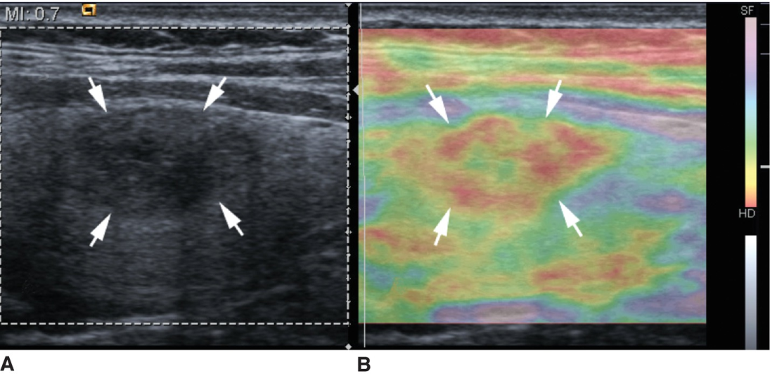
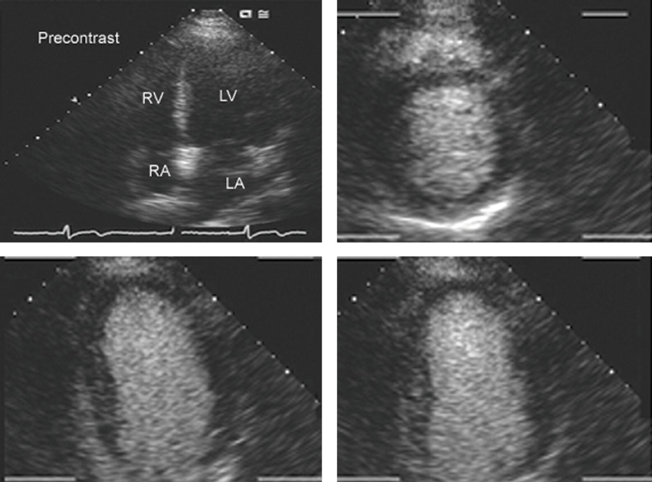
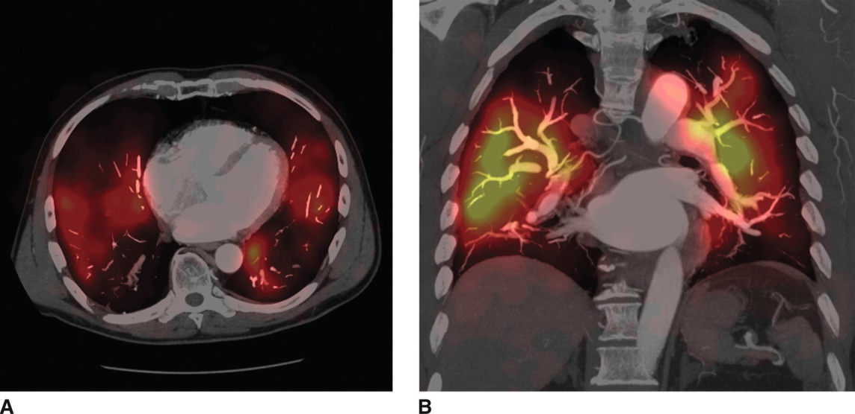
Additional Technologies and Future Applications (cont.)
Elastography
Contrast sonography
Fusion imaging

Slide 40
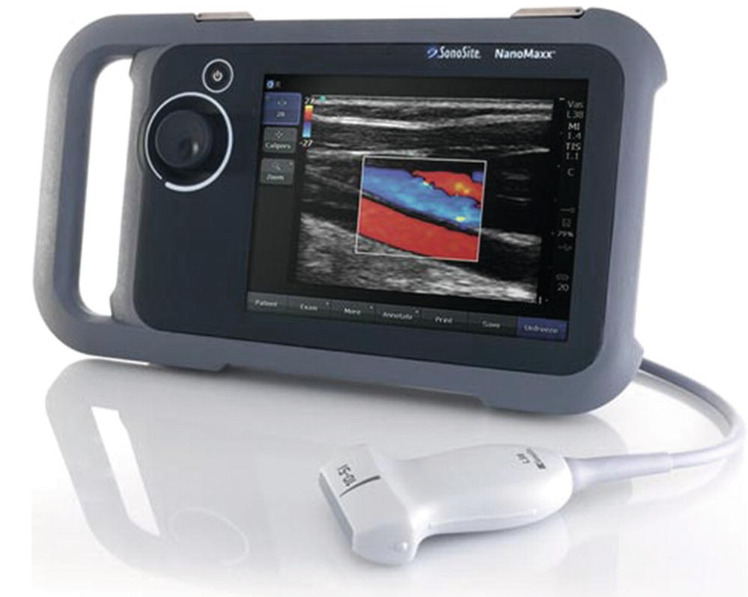
Additional Technologies and Future Applications (cont.)
Automated ultrasound is steered by a computer system.
Focused assessment with sonography for trauma offers the emergency room physician a quick and sensitive method of diagnosing abdominal trauma.
Miniaturization of equipment has led to higher-definition monitors and smaller computer system housing.
Wireless technology allows the transducer to communicate with the ultrasound machine without a cord getting in the way.

Slide 41
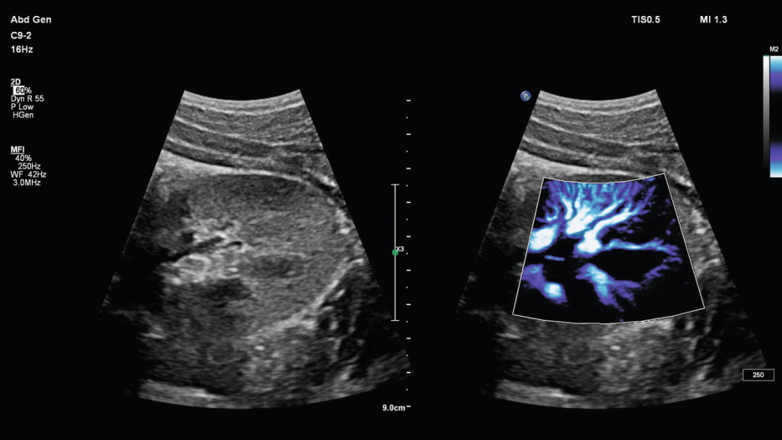
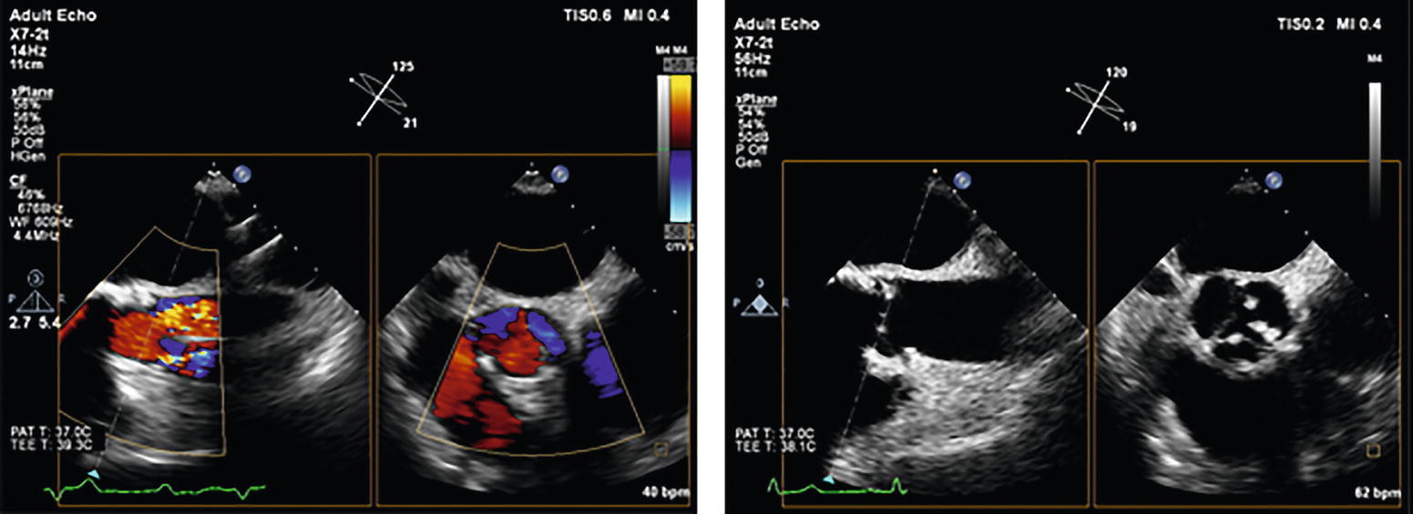
Additional Technologies and Future Applications (cont.)
MicroFlow Imaging from Philips
xMATRIX transducer from Philips

Slide 42
Summary
This chapter is just a starting point for you to begin your studies.
It should be apparent from the reading that our profession is constantly growing.
One vital role of the sonographer is to maintain a thorough knowledge base regarding the sonography profession.
Knowing that the medical uses of ultrasound are constantly evolving should provide you with both enthusiasm about your opportunities going forward and reassurance that you have chosen a wise career path.

